Slide 1
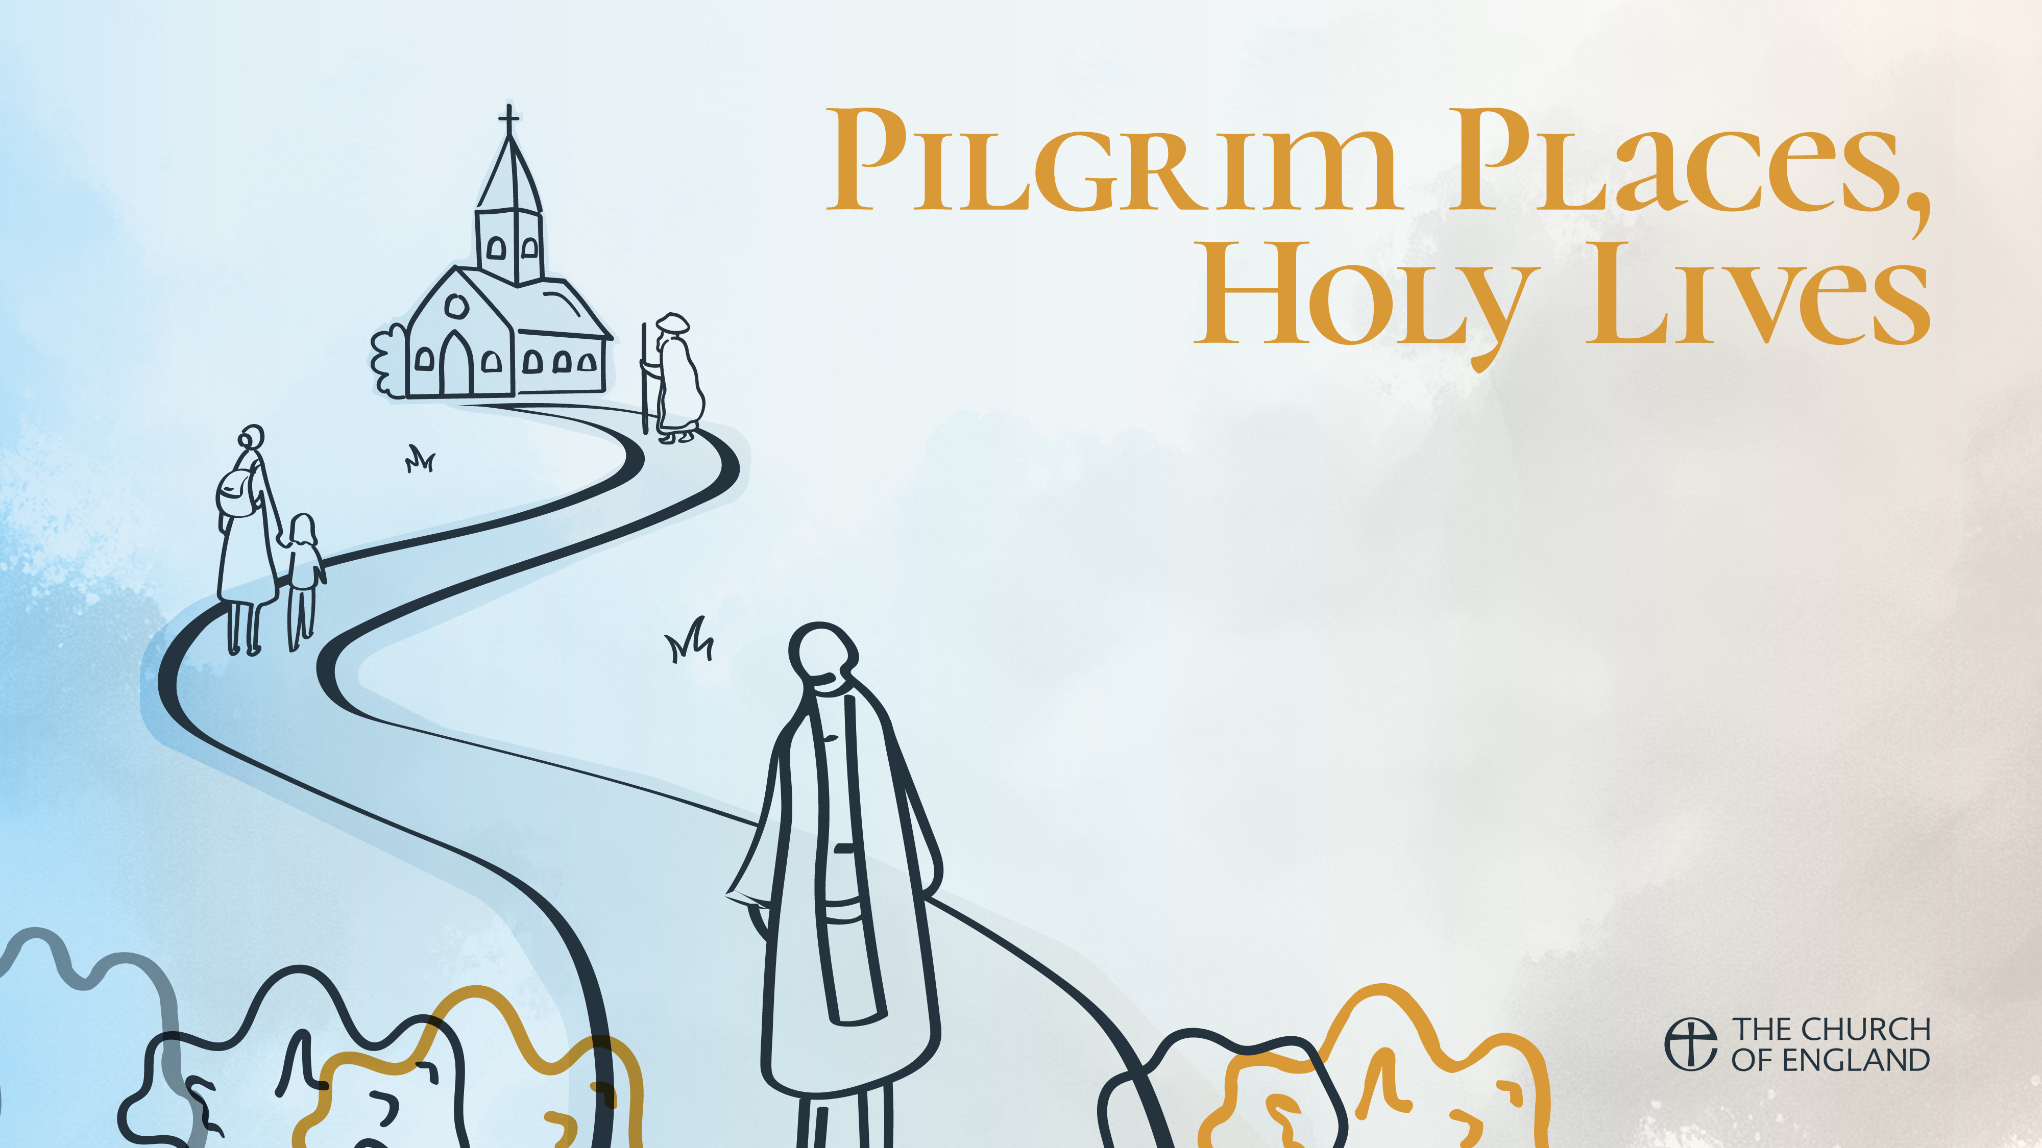
Week 4: St Alcuin of York & Hild of Whitby
Walking in Darkness
Readings: Psalm 139.10-11
            Psalm 119:105
            Psalm 96.9
            Isaiah 9.2
            1 Thessalonians 5.11
            Matthew 5.16

Slide 2
Psalm 139.9-12
If I take the wings of the morning and settle at the farthest limits of the sea,
even there your hand shall lead me, and your right hand shall hold me fast.
If I say, “Surely the darkness shall cover me, night wraps itself around me,”
even the darkness is not dark to you; the night is as bright as the day,
for darkness is as light to you

Slide 3

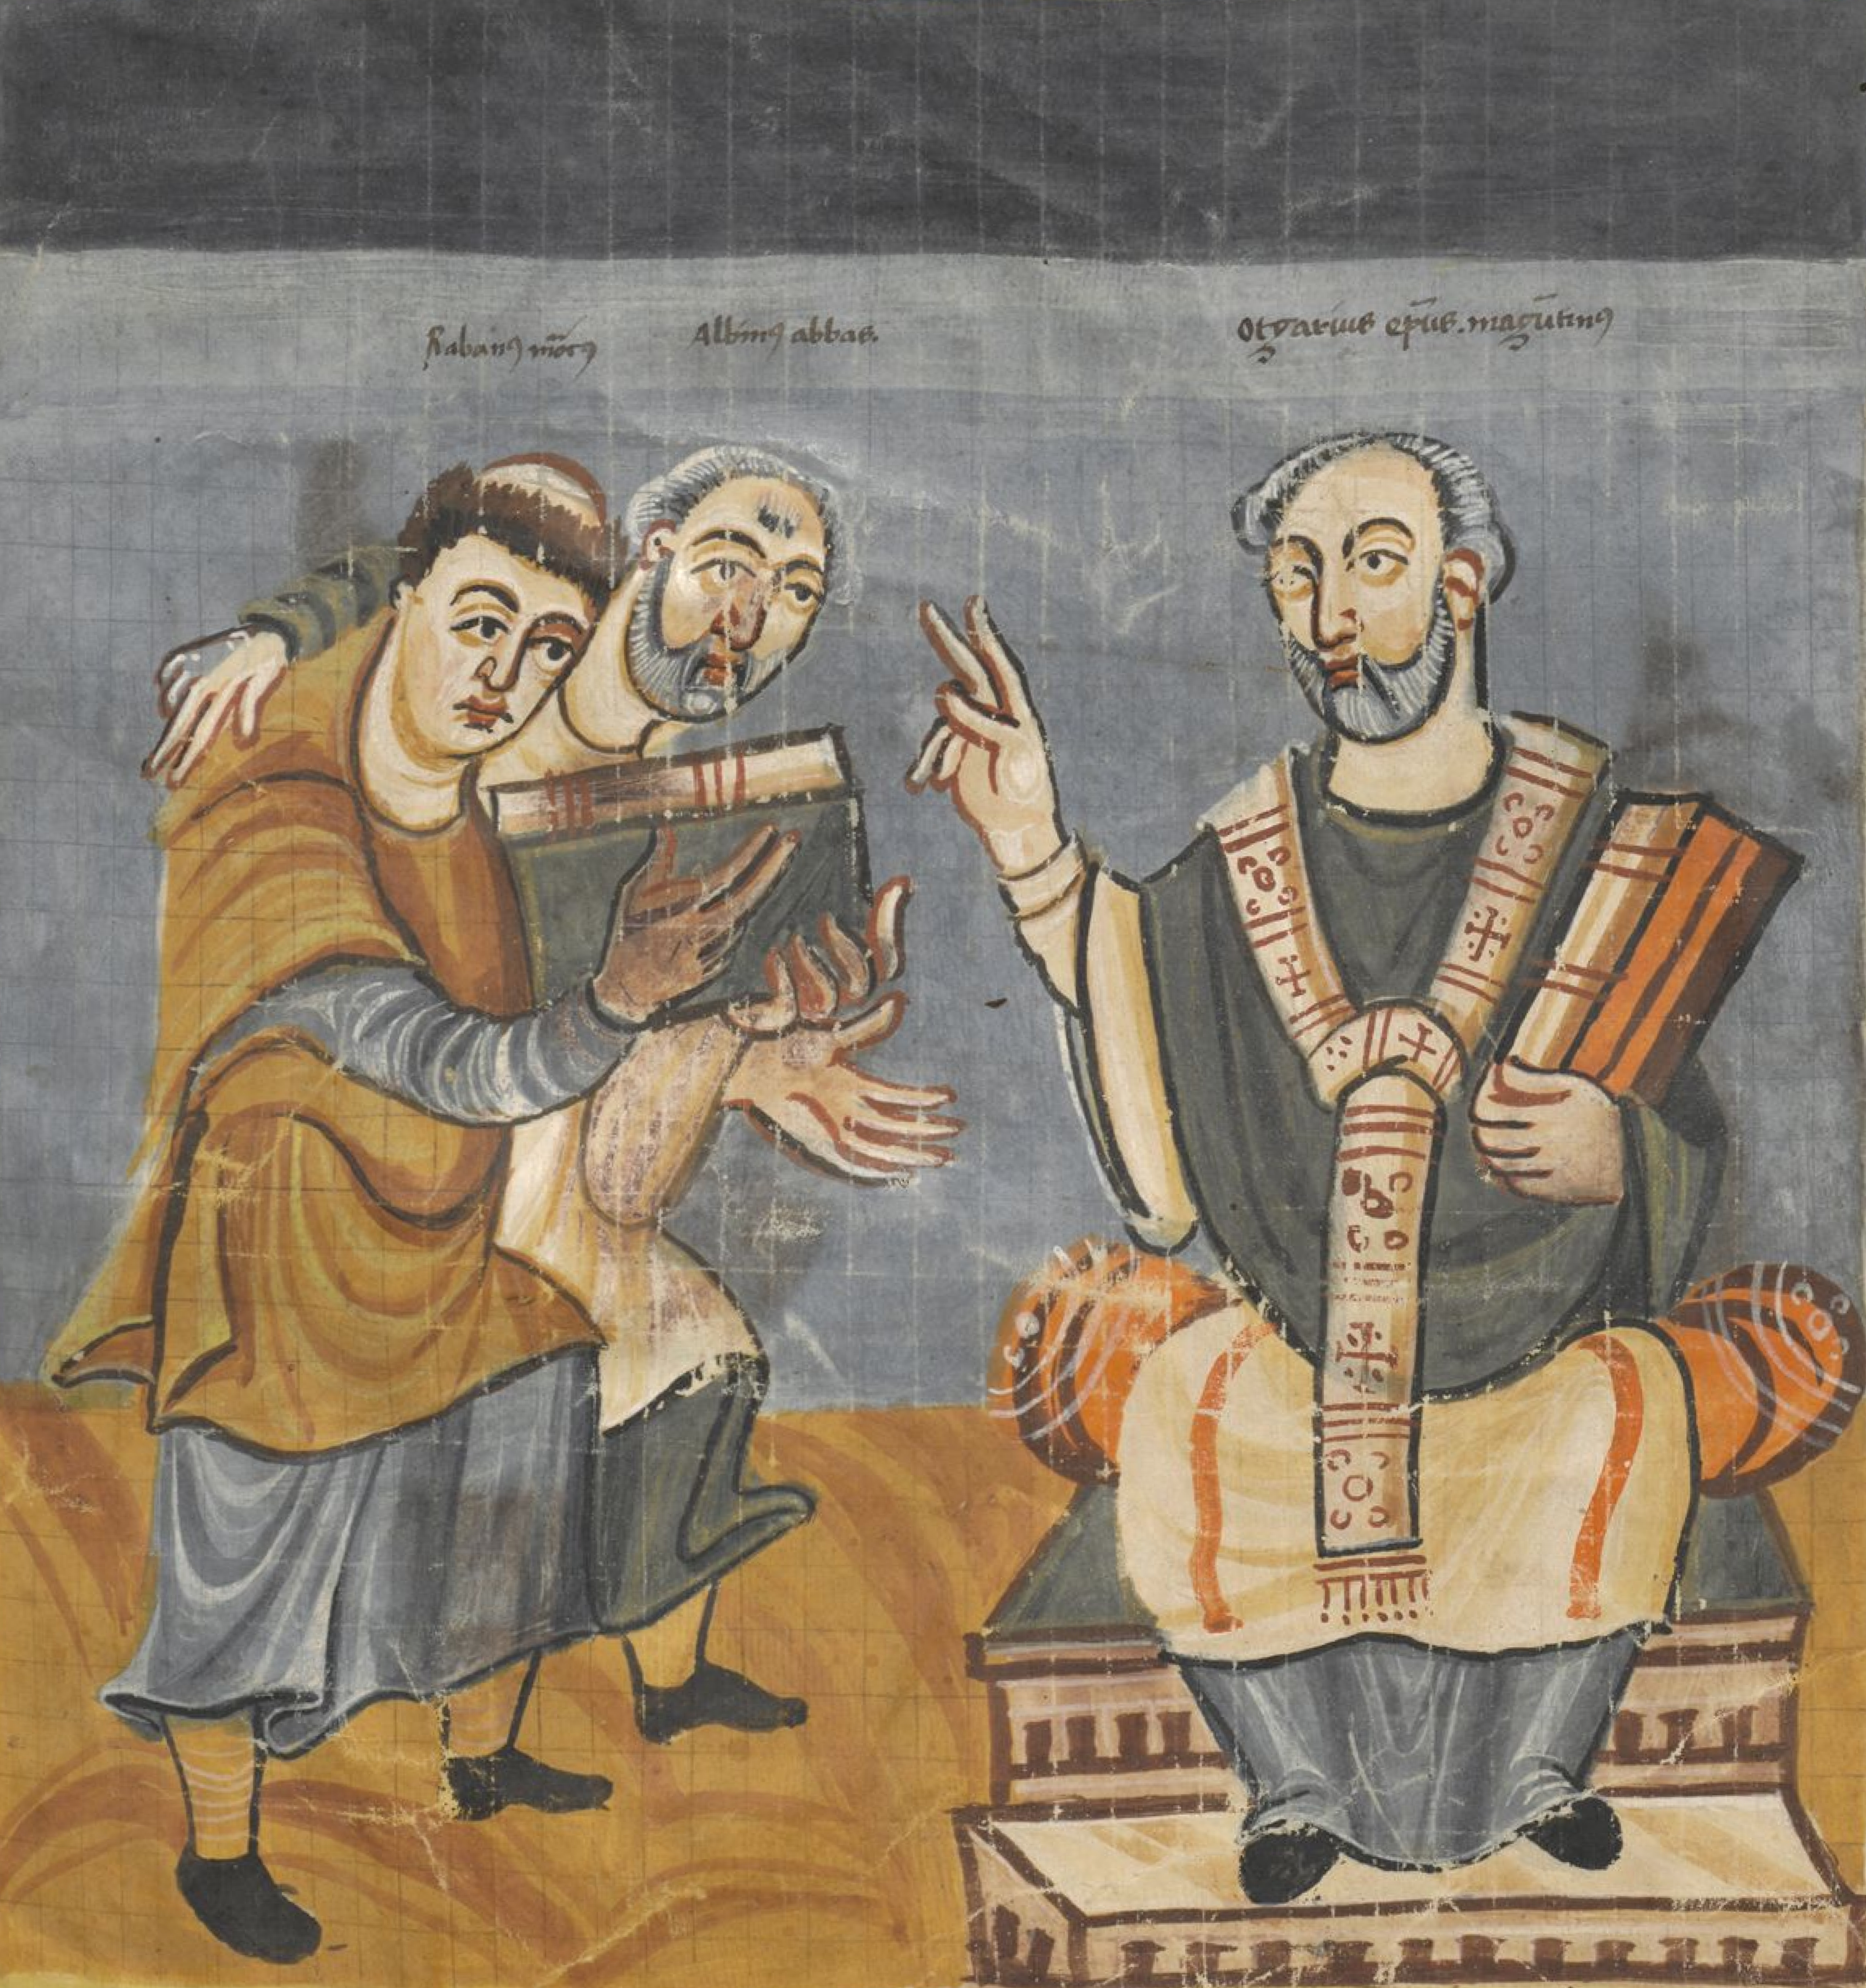
St Alcuin of York
735-19 May 804
Anglo-Saxon Scholar
Carolingian Renaissance
Charlemagne & Aachen
The ‘Liberal Arts’ (Mathematical and Verbal)
Preservation of text - punctuation, lower case, space between words - this font (like all on a screen) are descendants of Carolignian script!
Defender of literacy and advisor to power

Slide 4
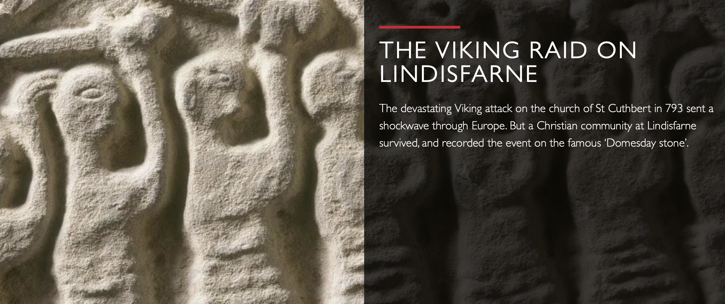
St Alcuin of York

Slide 5
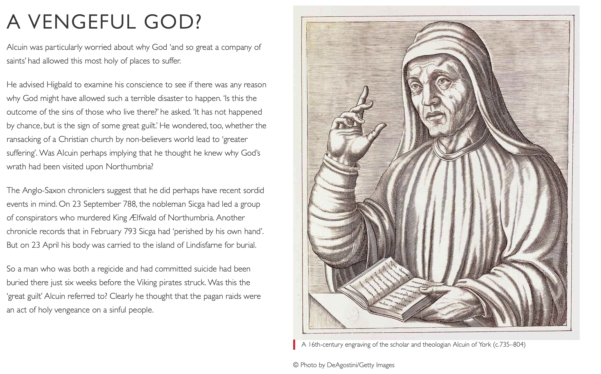

Slide 6
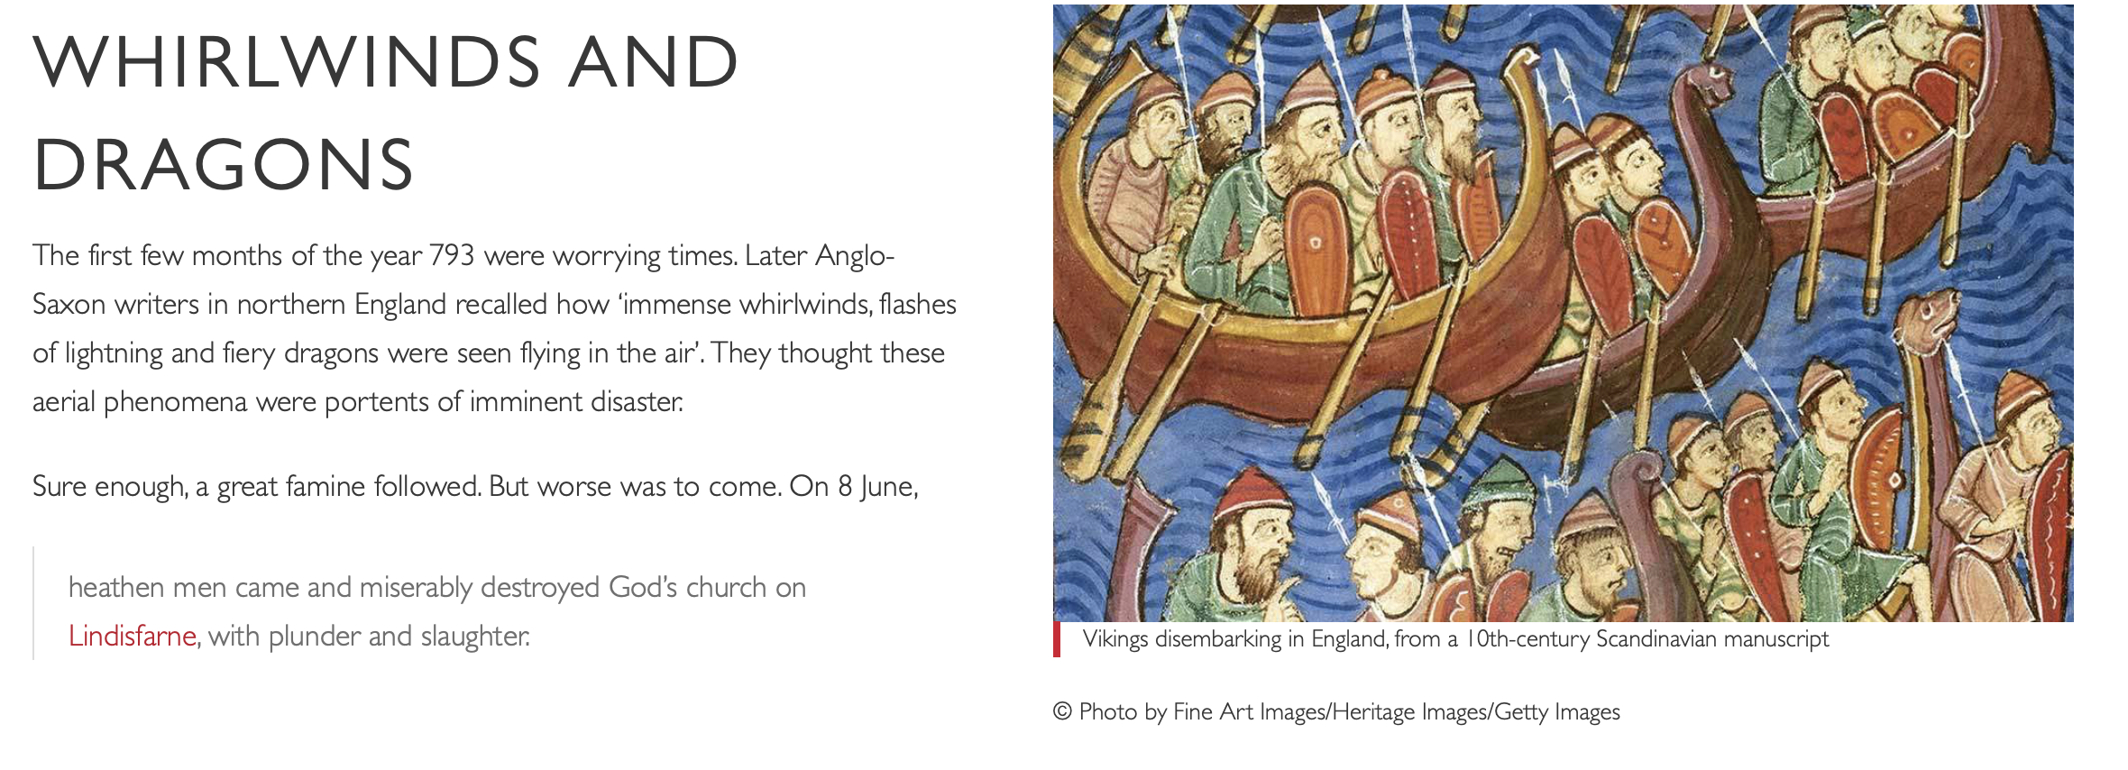

Slide 7
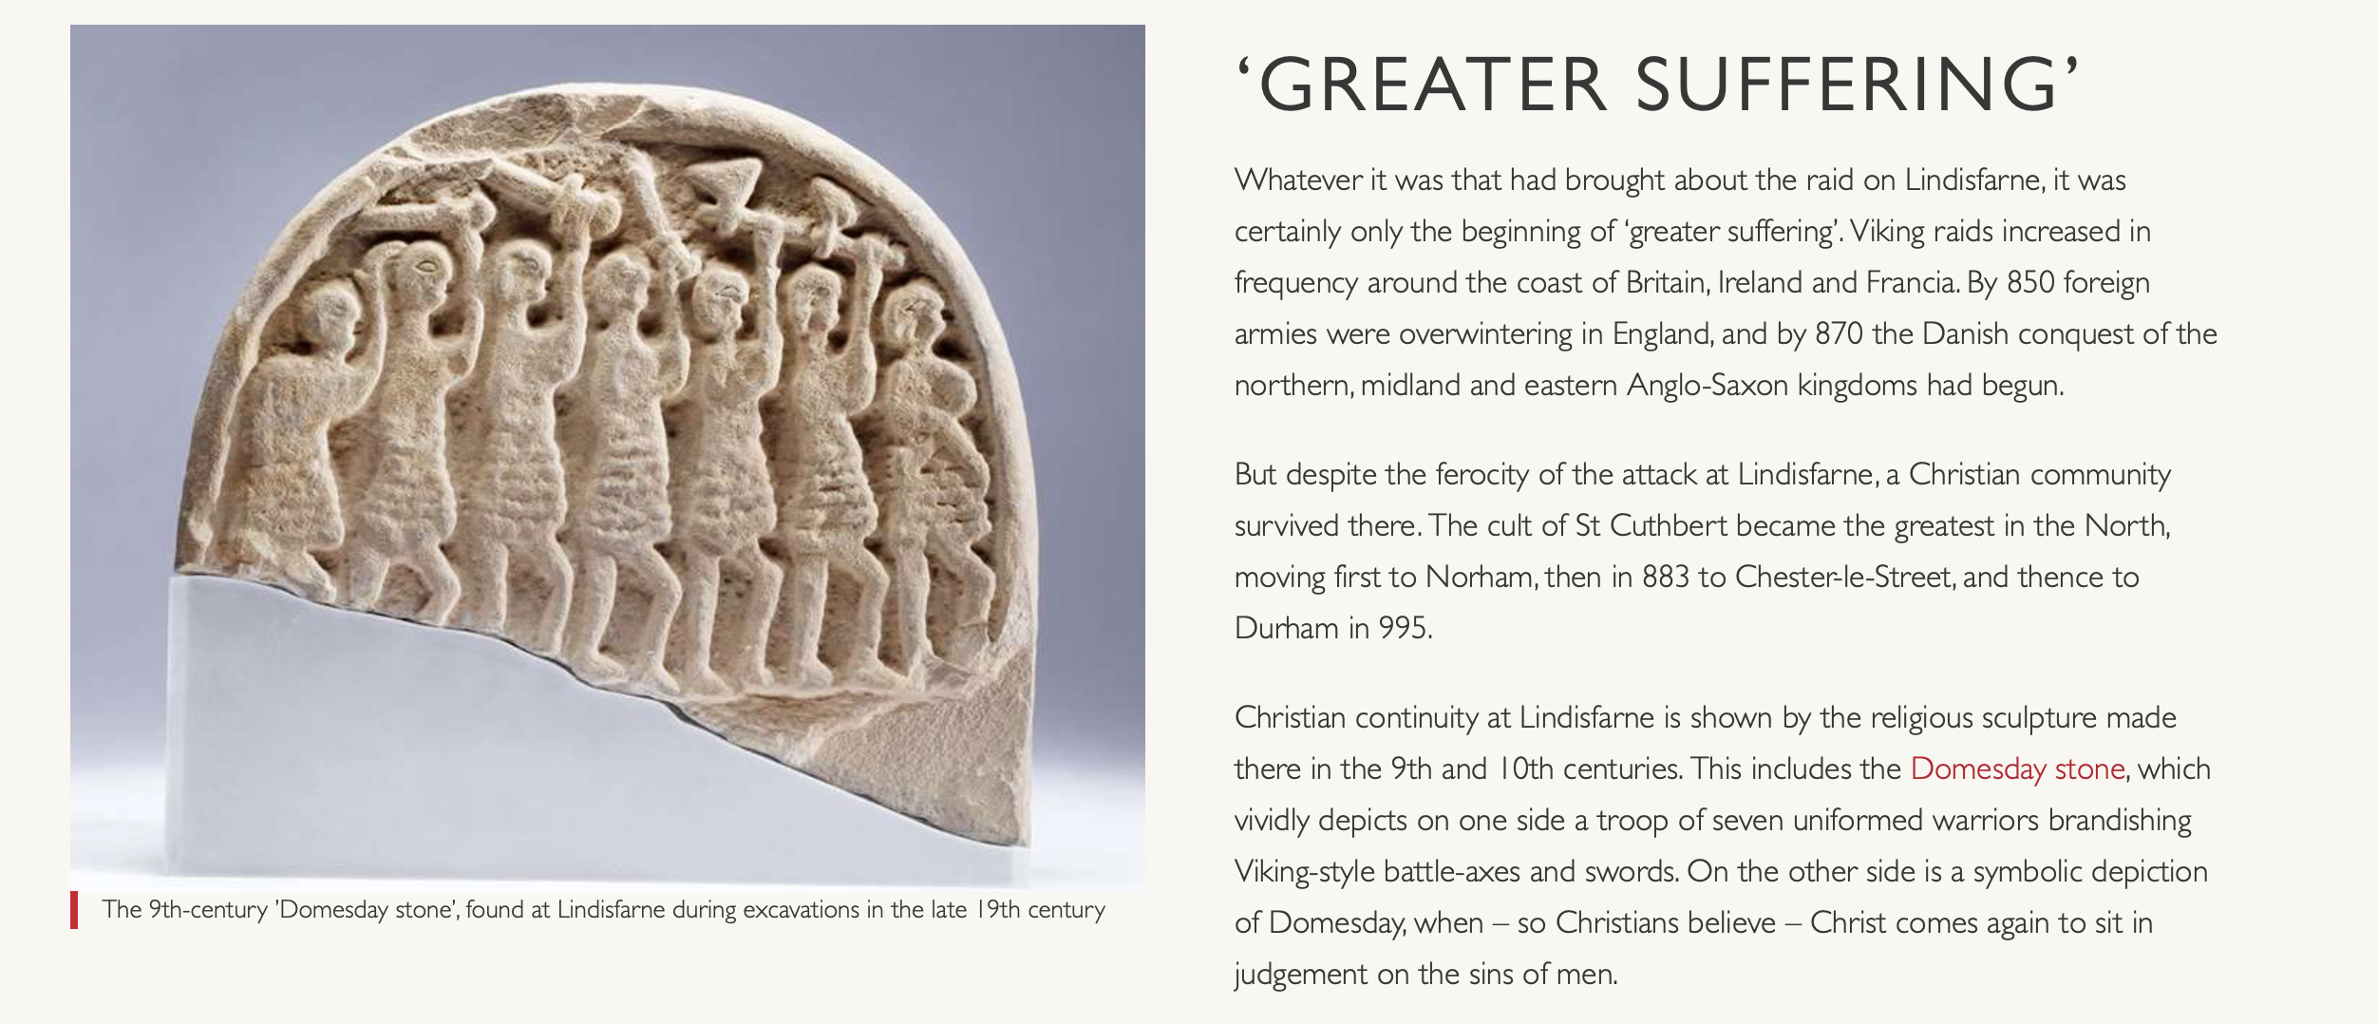

Slide 8
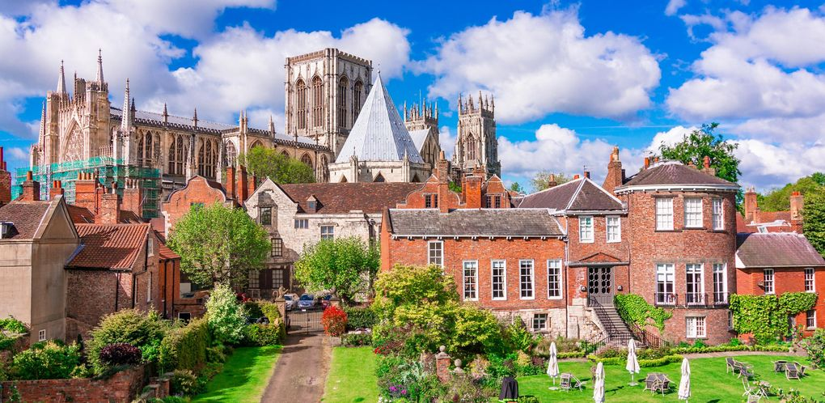
York

Slide 9

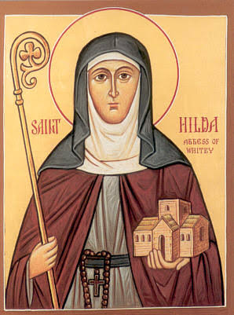

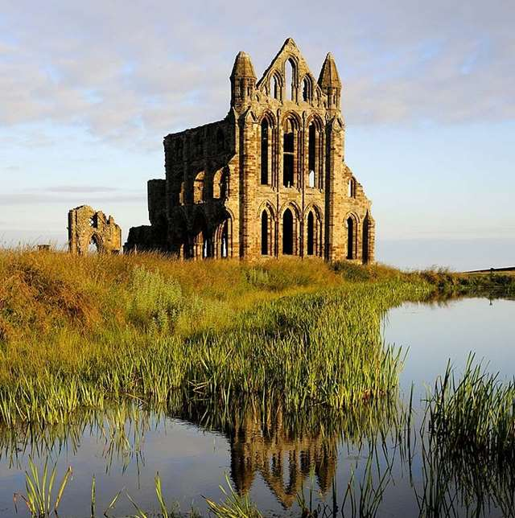
St Hild(a) of Whitby
614-680
Royal beginnings and conversion
The Great Abbess of Whitby
Major legacies: Synod of Whitby
Patron of English poetry
Death and local legend
Legend of Whitby Ammonites

Slide 10
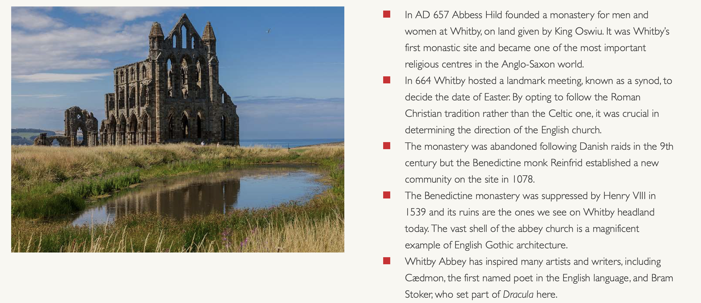

Slide 11
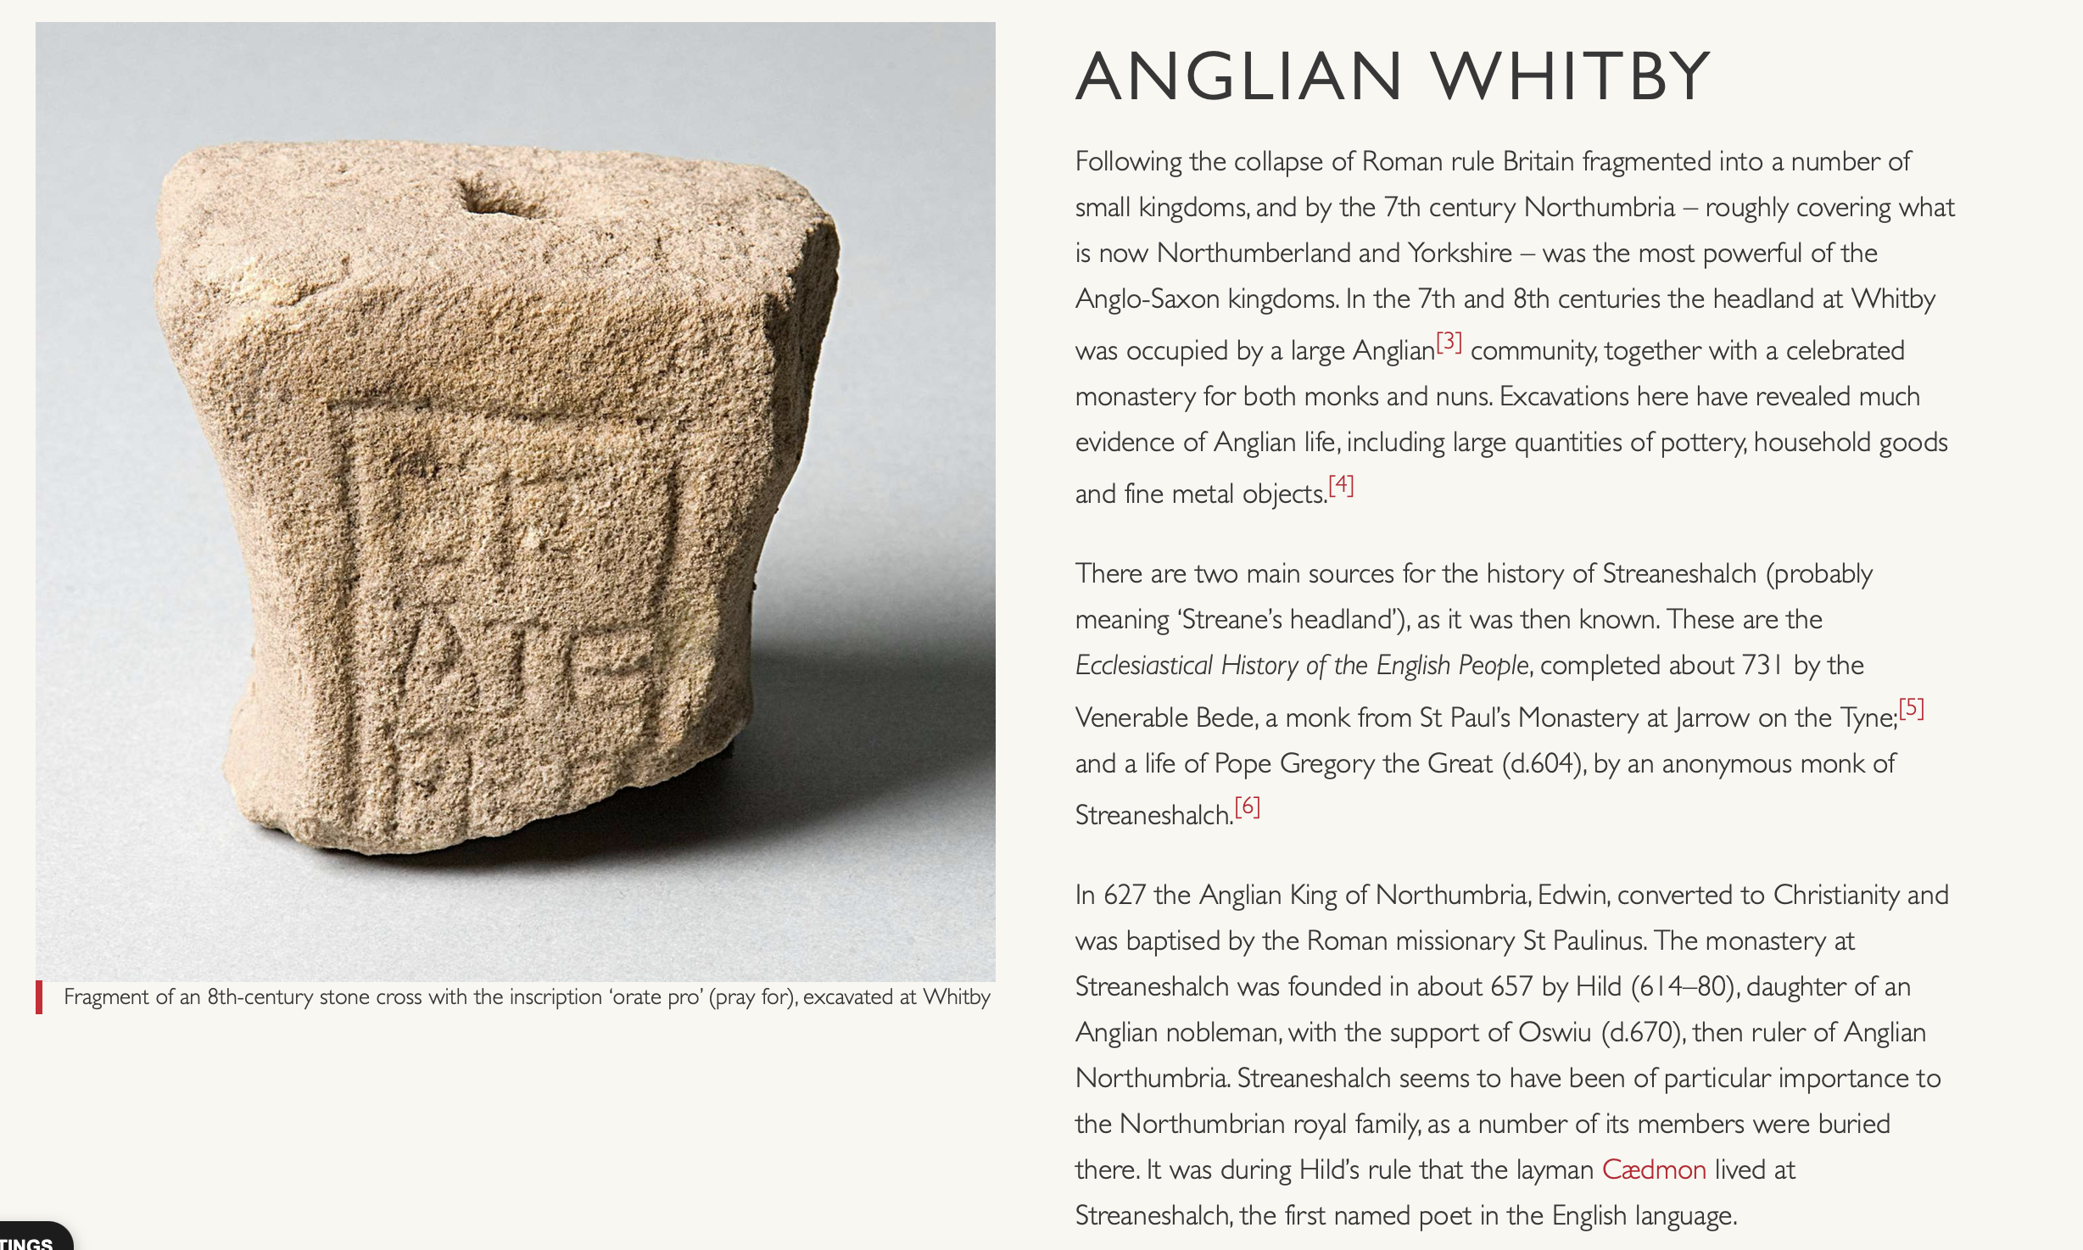

Slide 12
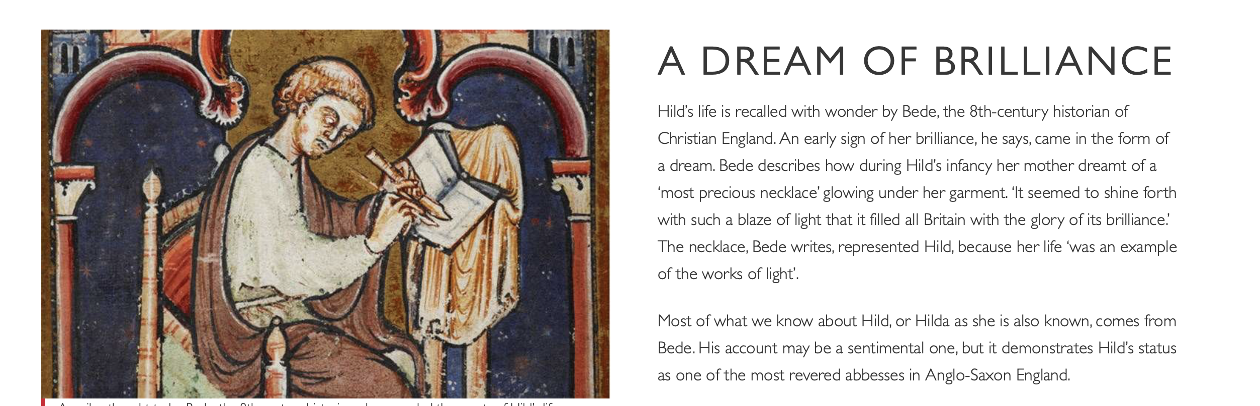

Slide 13
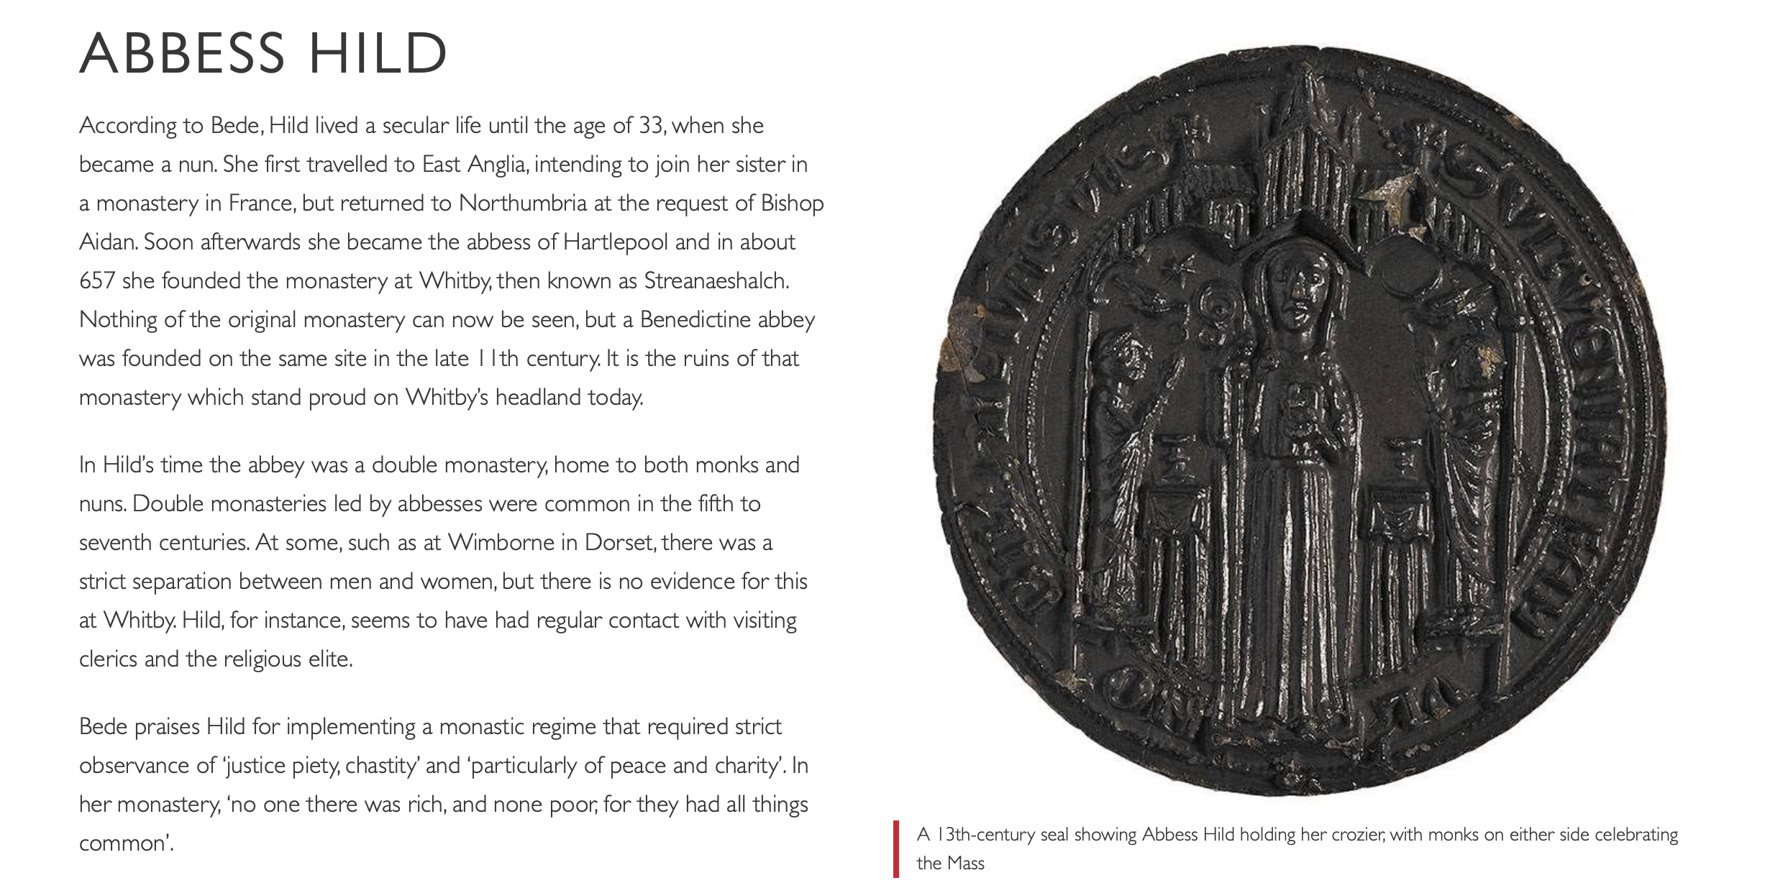

Slide 14
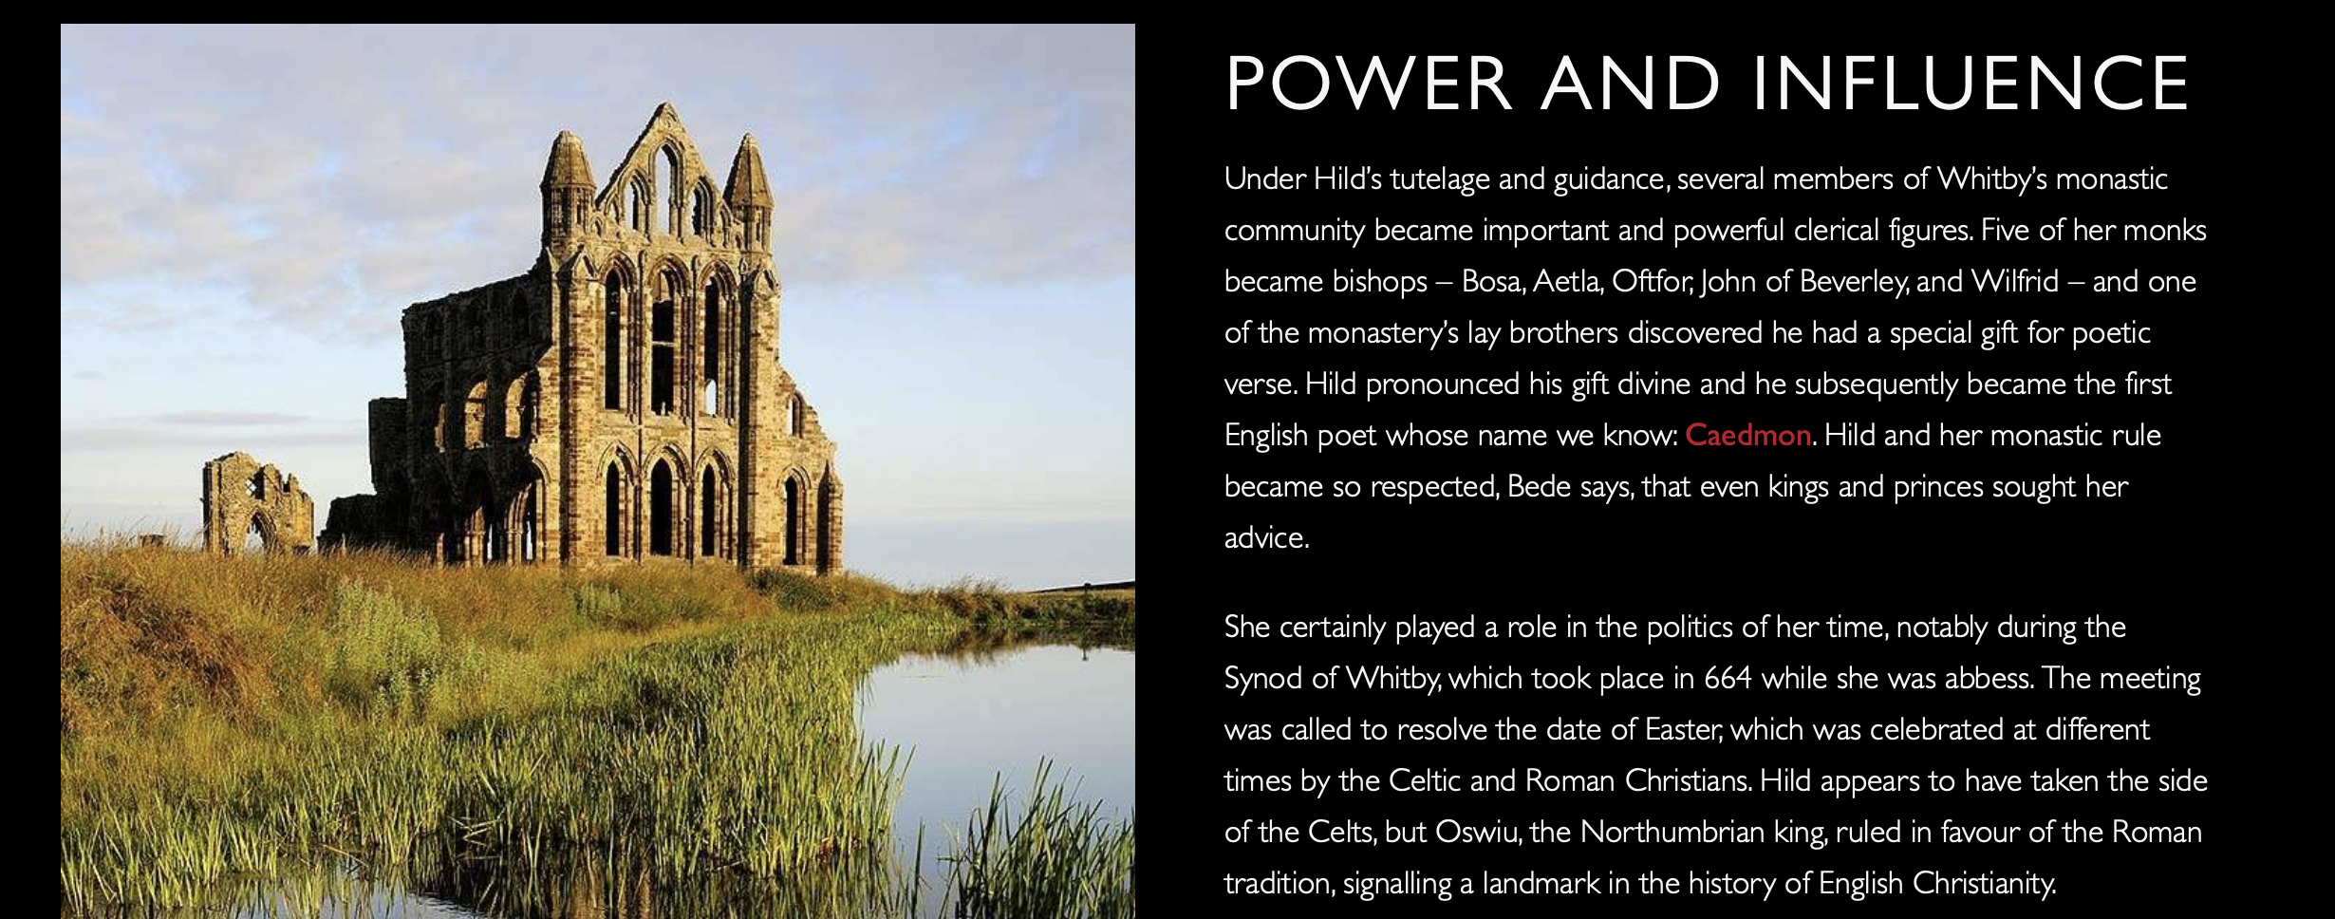

Slide 15
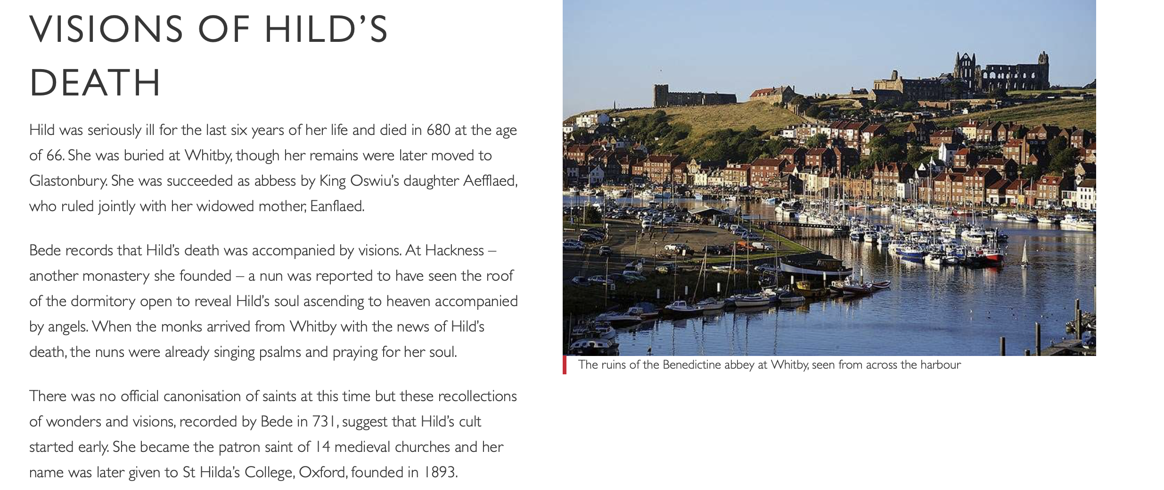

Slide 16
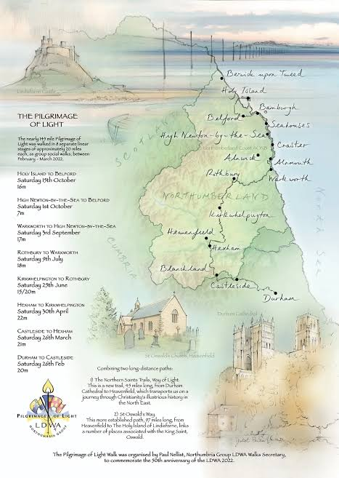


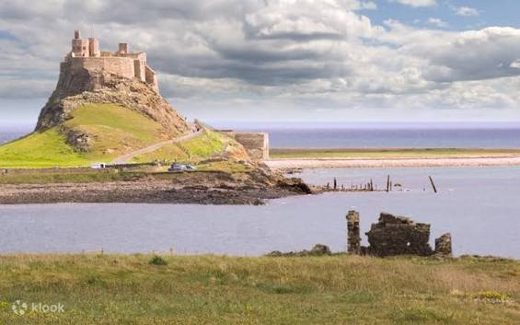
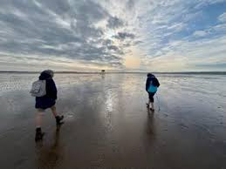

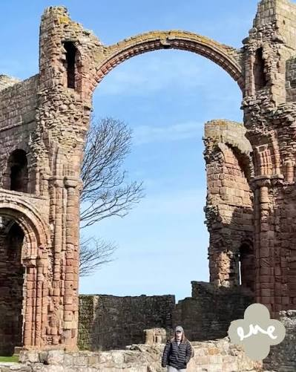
The Geographical connection: Northumbrian Pilgrimage

Slide 17
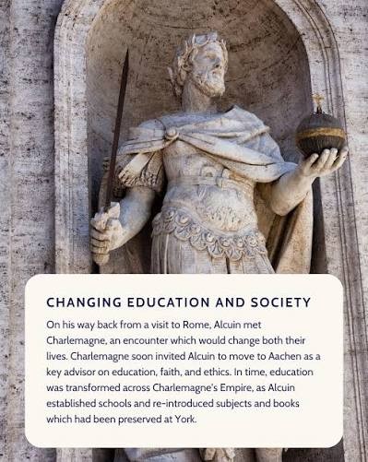
Alcuin - Pilgrimage as Education and Diplomacy

Slide 18
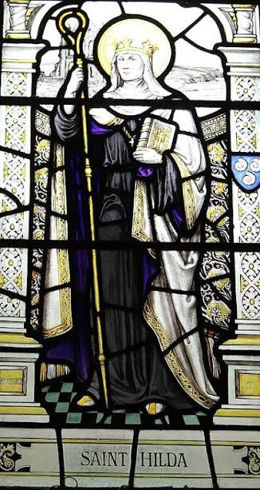
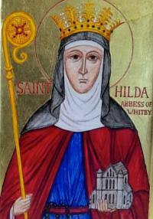
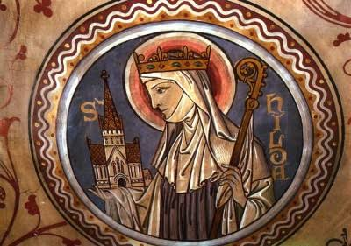
Hild: The Spiritual Director of Pilgrims

Slide 19

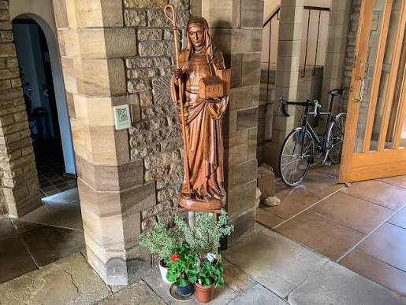
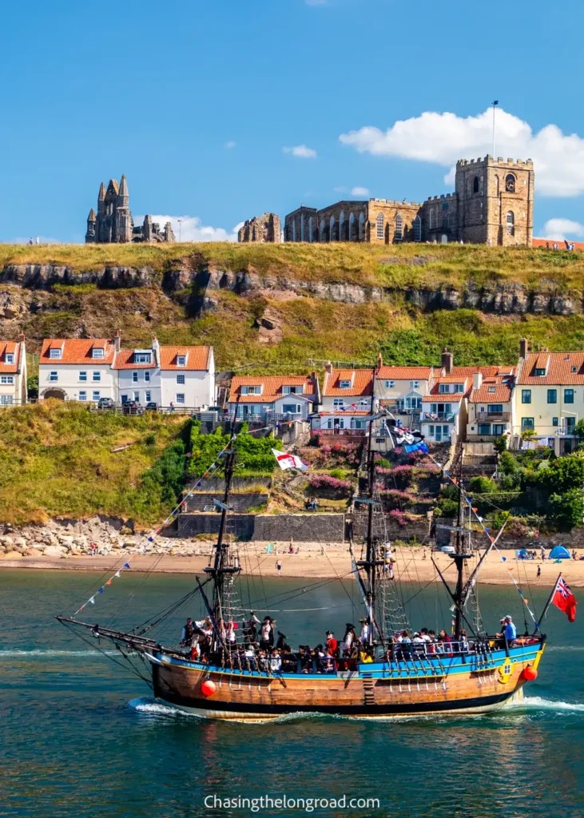
The Modern day connection
- the Hilda Way

Slide 20
What does Hild teach us today?
What does Alcuin teach us today?

