Slide 1
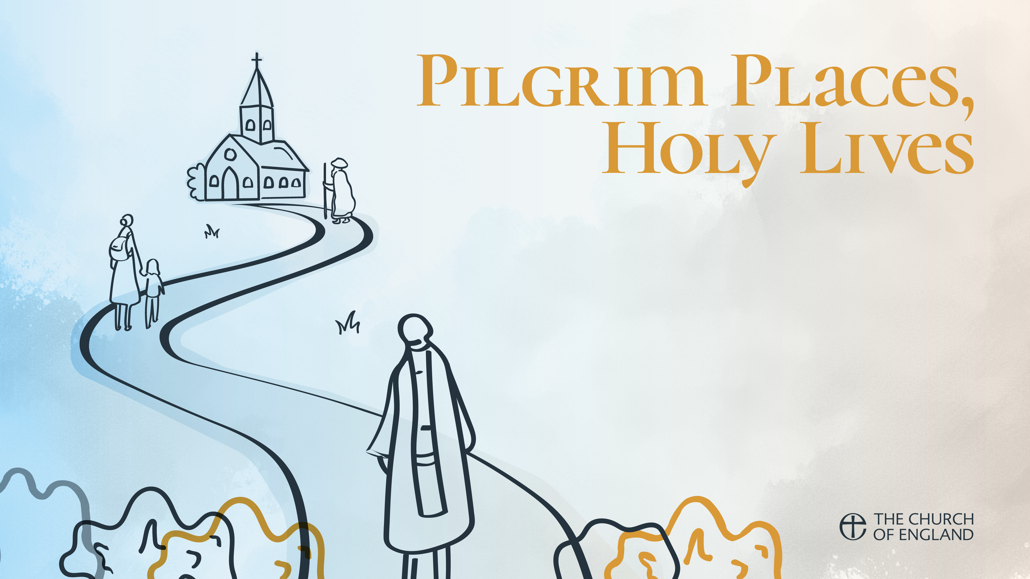
Week 1: The Venerable Bede and St Bertha
How the Gospel took root in Anglo-Saxon England
Continuing the pilgrimage journey of spreading the word, welcoming others
Reading: John 1.1-5, 10-14

Slide 2
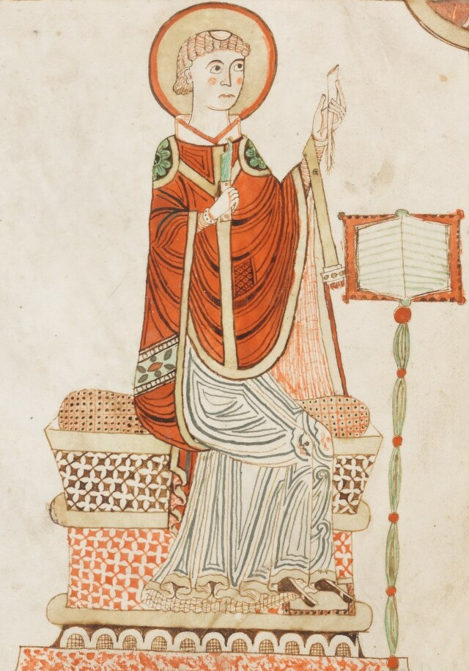
The venerable bede
c 693-735
Educated by monks, moved with his abbot who founded St Paul’s monastery, Jarrow, when aged 12
Became a Benedictine monk, priested by 30, remained there until his death
Travelled to York to visit the Bishop, and the monastery on Lindisfarne
Bones are buried at Durham Cathedral since 1022, alongside Cuthbert’s relics

Slide 3
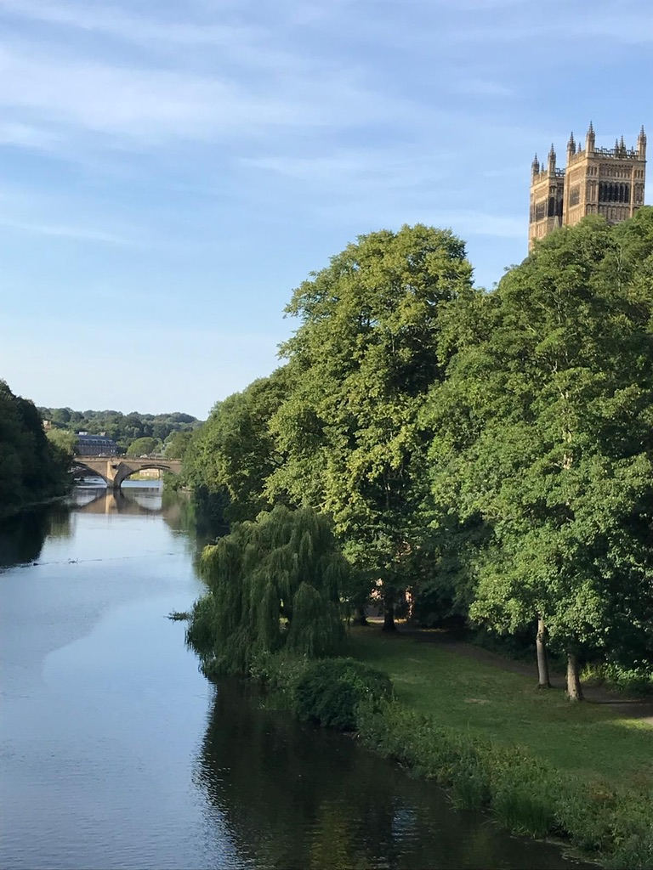
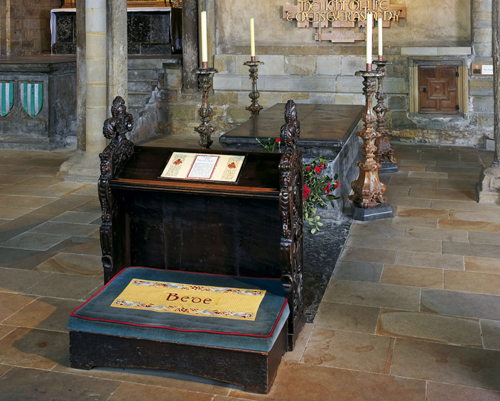
The venerable bede
Devoted his life to studying scriptures, became mediaeval England’s greatest scholar
The first to record the history of England: Historia Ecclesiastica Gentis Anglorum
Studied computus, the science of calculating calendar dates, including efforts to decipher the original date of Easter.

Slide 4
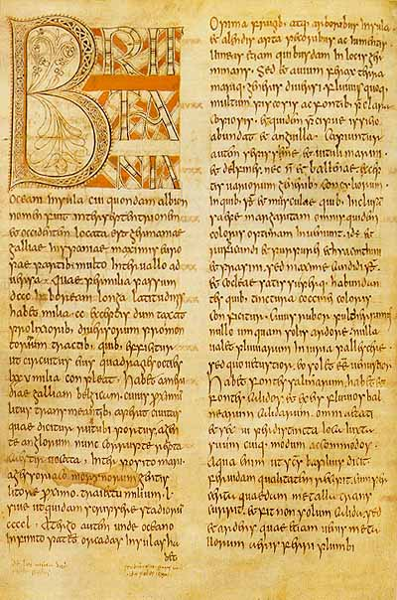
Ecclesiastical History of the English People
800 years of English history from the Caesar’s invasion of Britain
A history of social and political life
Documents the rise of the early Christian church, to St Augustine’s arrival in Canterbury
The first work of history to use the AD system of dating to measure time based on the birth of Christ, anno domini

Slide 5
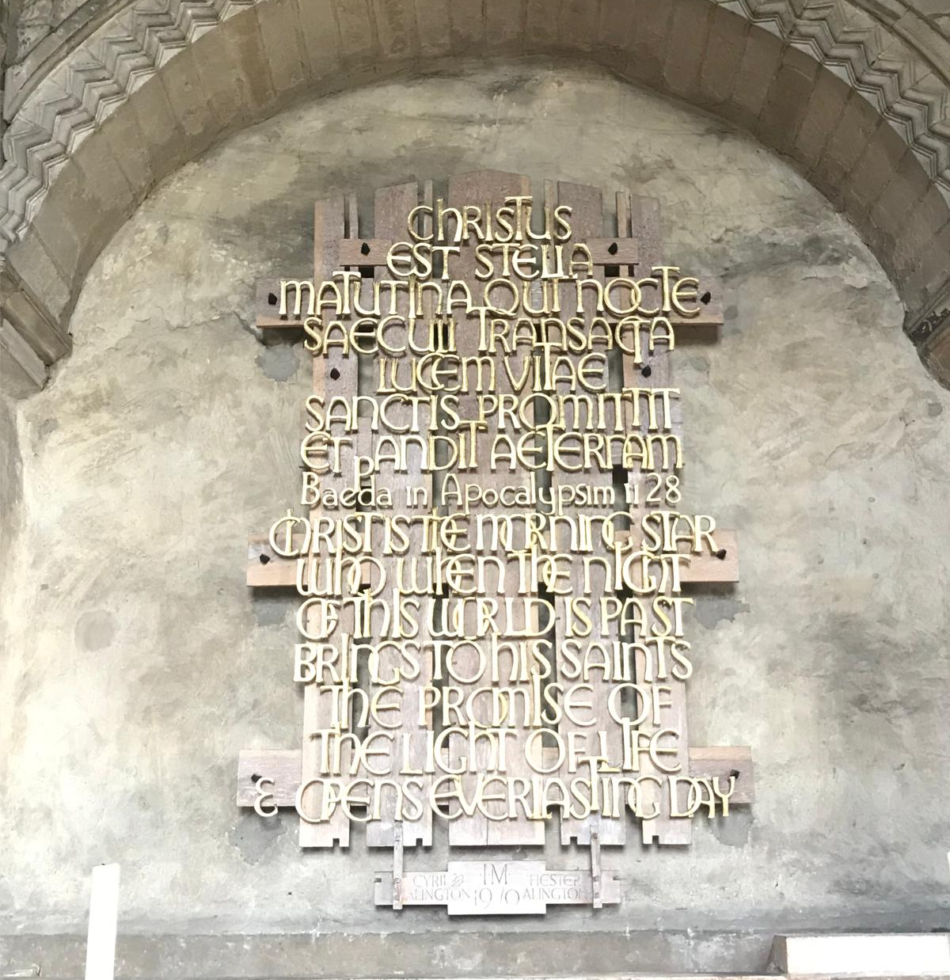
Bede’s writings
Contributed to the spread of the Gospel
At its heart, a relationship with Christ
Offered security – pilgrims on a purposeful journey towards an eternal home
Context was the uncertainty of Anglo-Saxon daily life
New values, courage to take risks, forgiveness and the offer of a new life to rich and poor alike.
Using power for good – justice and care for others.

Slide 6
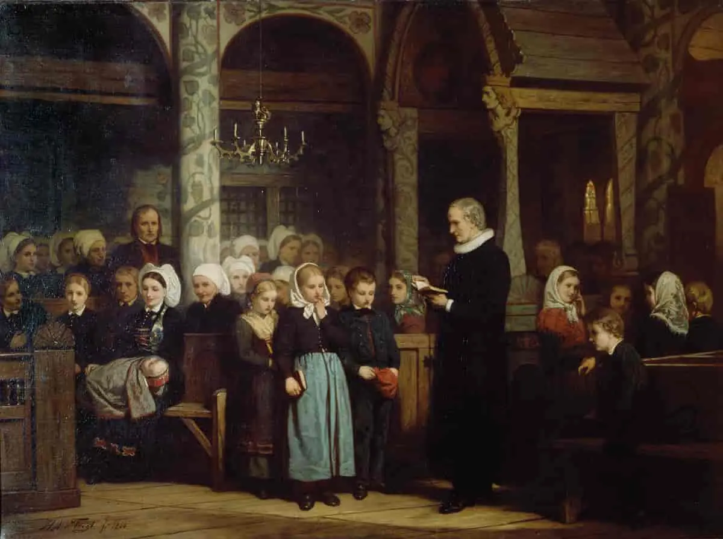
St Nicolas post-reformation
Our record at St Nicolas homilies from the 17th century
Post-reformation focus on education and teachibg
Readers were laymen allowed to read the services of the 1559 Prayer Book
Pastoral and political tools by the Church of England to maintain orthodoxy
The Readers read the homilies to the congregation.

Slide 7
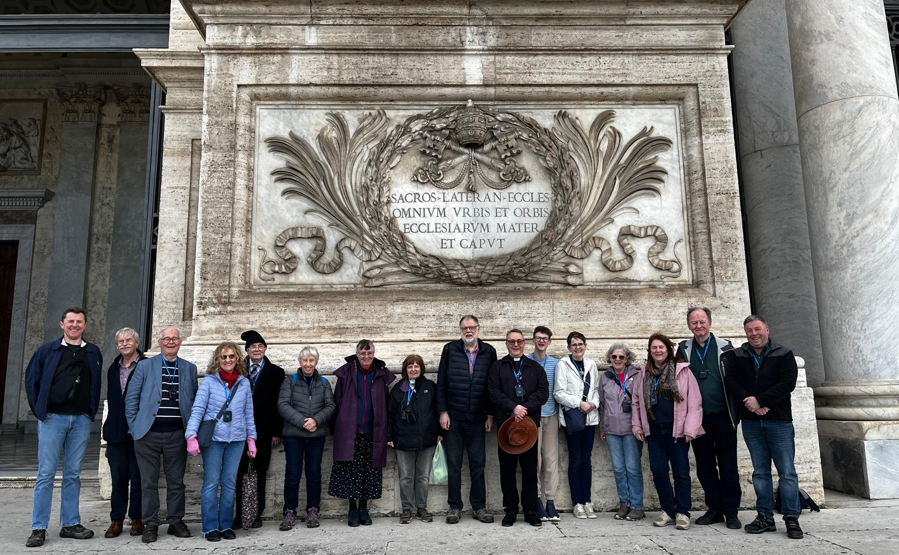

Continuing the Pilgrimage Journey
Reading: 1 Peter 2.9-11
Seeing God at work in every encounter with the Gospel, every pilgrim journey
Spreading the word, planting seeds of faith which transform
Rediscovering what it means to welcome others

Slide 8
Questions
Do you find pilgrimage a helpful way of thinking of your faith journey?
Where are we as church and individuals on our journey?
How do we reflect God’s love and values ?

Slide 9
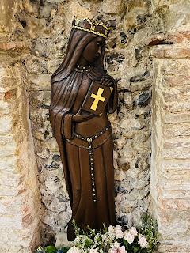
BERTHA OF KENT
Born around 560 AD
Grew up as a Frankish princess near Tours, France.
Father was Charibert I, King of Paris.
Married Aethelberht, pagan king of Kent around 580 AD
A political alliance between the Franks and Anglo-Saxons.

Slide 10
BERTHA OF KENT
A key condition of the marriage - Bertha was allowed to continue practising her Christian faith.
She brought her chaplain, Liudhard, with her
A former Roman church near Canterbury was restored and dedicated to St Martin of Tours,
This became her private chapel.
Recognised as the oldest site of continuous Christian worship in the English-speaking world.

Slide 11
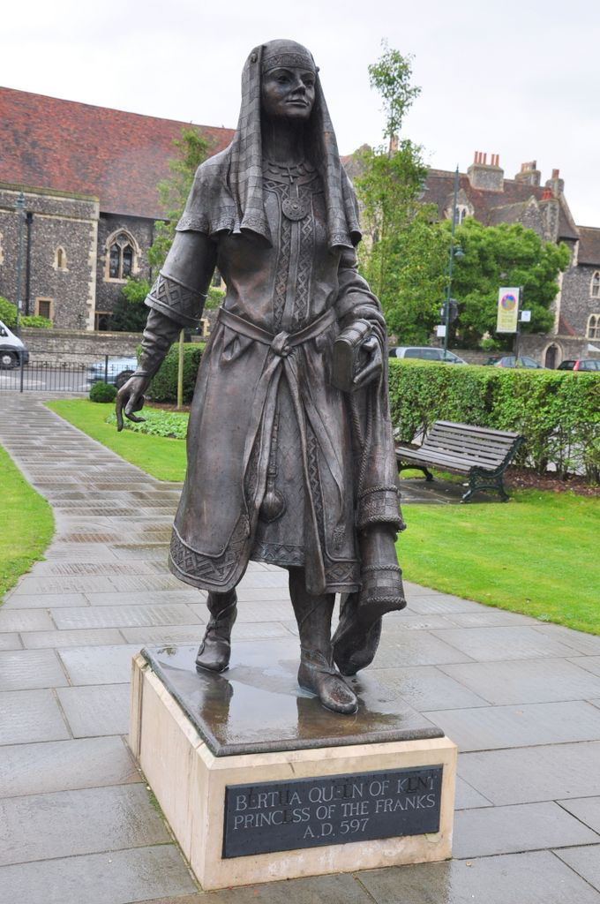
BERTHA’S ROLE IN THE RISE OF CHRISTIANITY IN ENGLAND
She played a role in St Augustine's mission (597 AD) to convert the pagan Anglo-Saxons to Christianity.
She encouraged her husband to welcome Augustine and allow him to preach freely and reside in Canterbury.

Slide 12
BERTHA’S ROLE IN THE RISE OF CHRISTIANITY IN ENGLAND
Aethelberht ultimately converted to Christianity
Bede wrote 'the fame of the Christian religion had already reached (Aethelberht) as a result of his wife's faith’.
Others said Aethelberht would already have been aware of Christianity without Bertha’s influence.

Slide 13
BERTHA’S ROLE IN THE RISE OF CHRISTIANITY IN ENGLAND
Bertha received a letter from Pope Gregory in 601 suggesting she had been negligent in not converting her husband before St Augustine's arrival.
He suggested she should encourage her husband to convert his whole country now.
The Pope gave her some credit for Augustine's welcome -compared her to Helena, the Christian mother of Constantine who became the first Christian emperor of Rome.

Slide 14
Questions
How do we feel about the Gospel of forgiveness and new life?
How do we share this with others in our own context?

Slide 15
Lord of hope and transformation, help us to find our security in you and invest in what will last. May our daily journeys reflect your mercy, grace and values as we serve you in the world.
May your gospel fill us with joy and wonder. Help us to share this with others, so they too may know your love and light.

